Slide 1


E CAR ACCESSORIES SHOPPING SYSTEM
Guided By:-
Mr. Chetan Pardeshi
Presented By:-
2004 Achal Jaiswal
2044 Samadhan Gaikwad

Slide 2
CONTENTS
Features for Customers
Features for Shop Owner(Admin)

Slide 3
FEATURES for CUSTOMER
01
02
03
Register
Login
Edit Details
New Visitors Registration module
Exciting Customers Login module
Customers may Edit their details

Slide 4
FEATURES for CUSTOMER
04
05
06
Product Listings
Shopping Cart
Payment
Customer may check various product category list with products
Customer may select and add products to shopping cart
Different payment options at the time of checkout

Slide 5
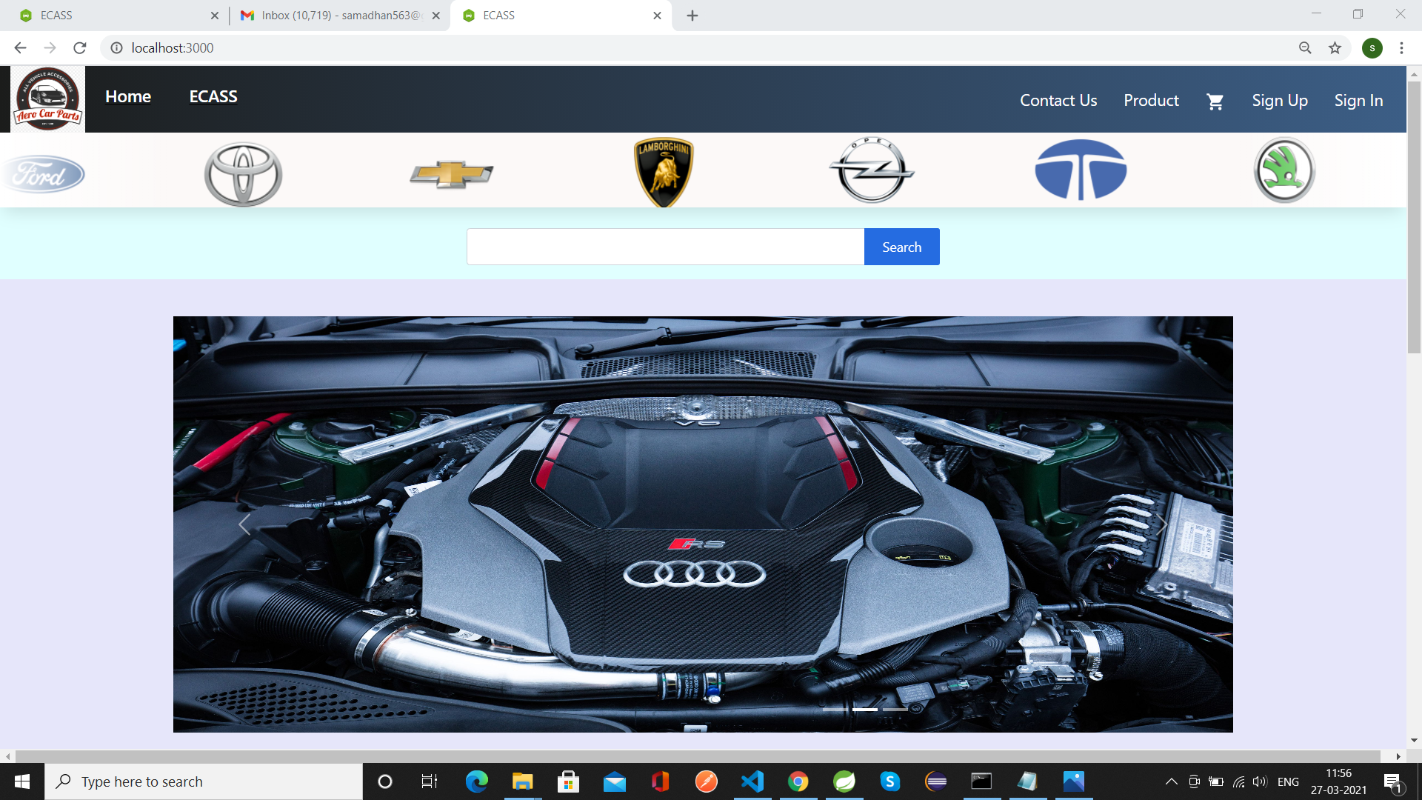
ECASS HomePage

Slide 6
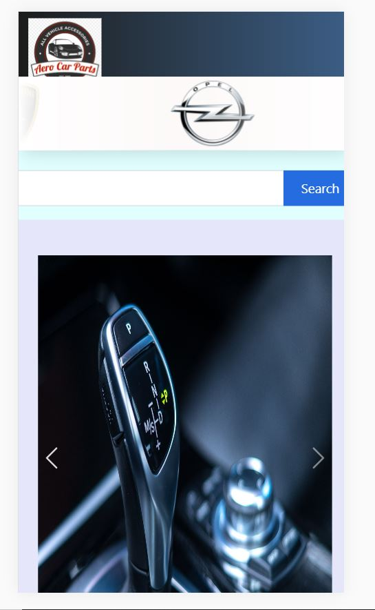
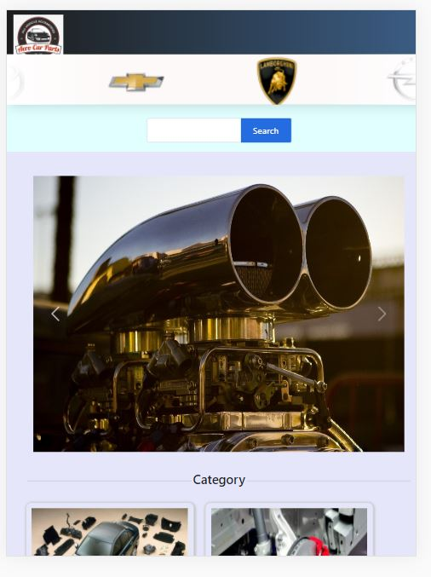
Home Page of ECASS

Slide 7
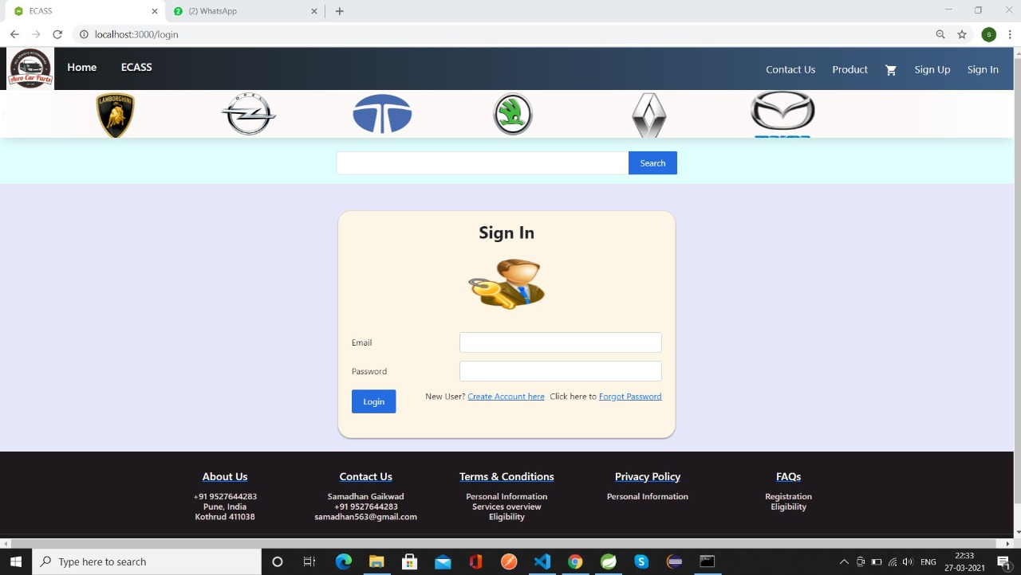
ECASS Login Page

Slide 8
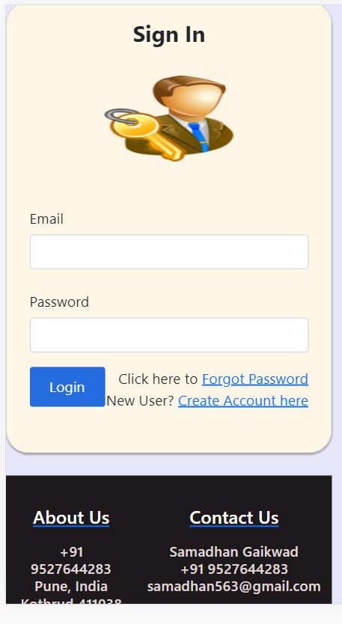
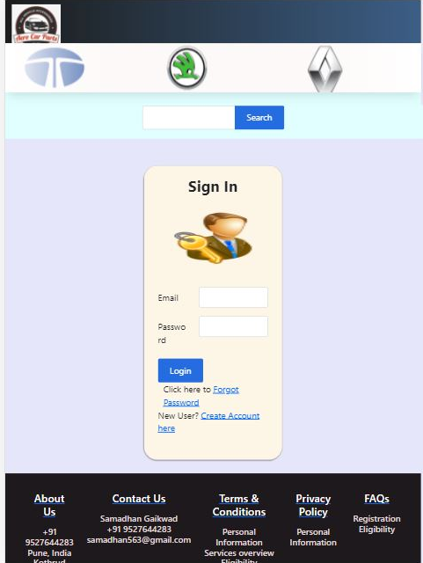
User Log-In module.

Slide 9
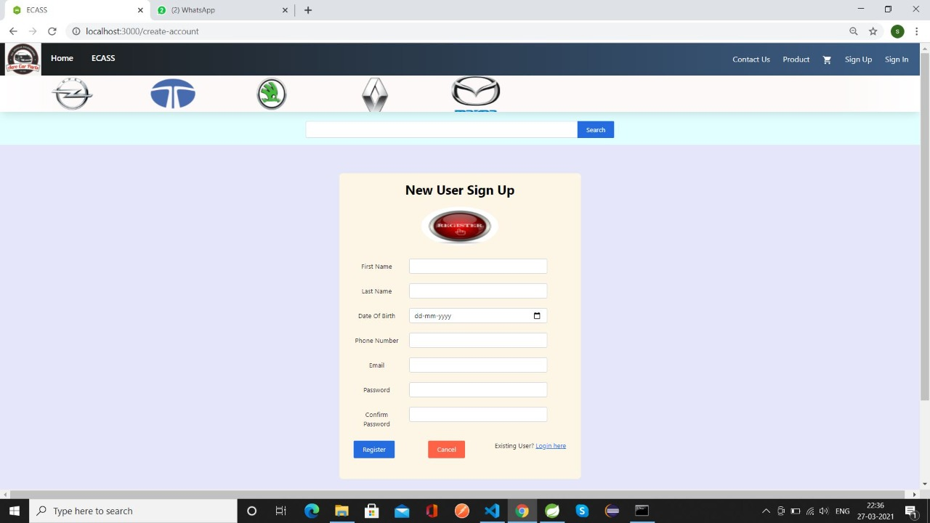
ECASS Registration Page

Slide 10
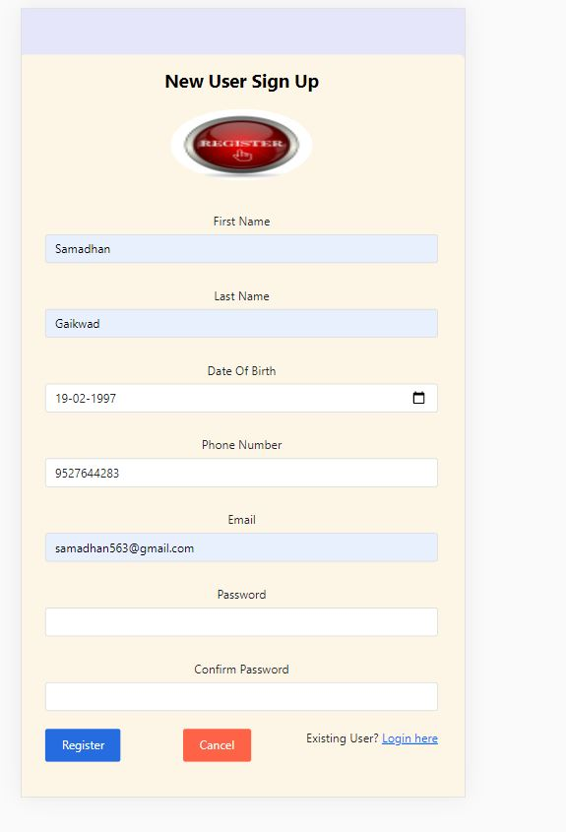
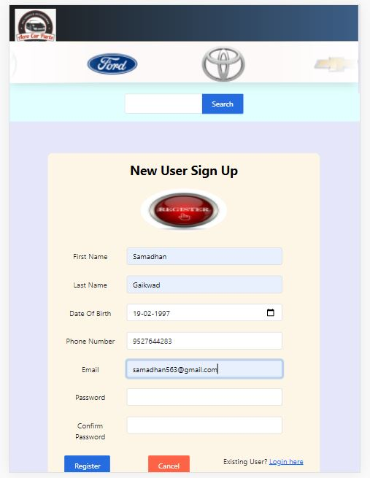
Registration module.

Slide 11
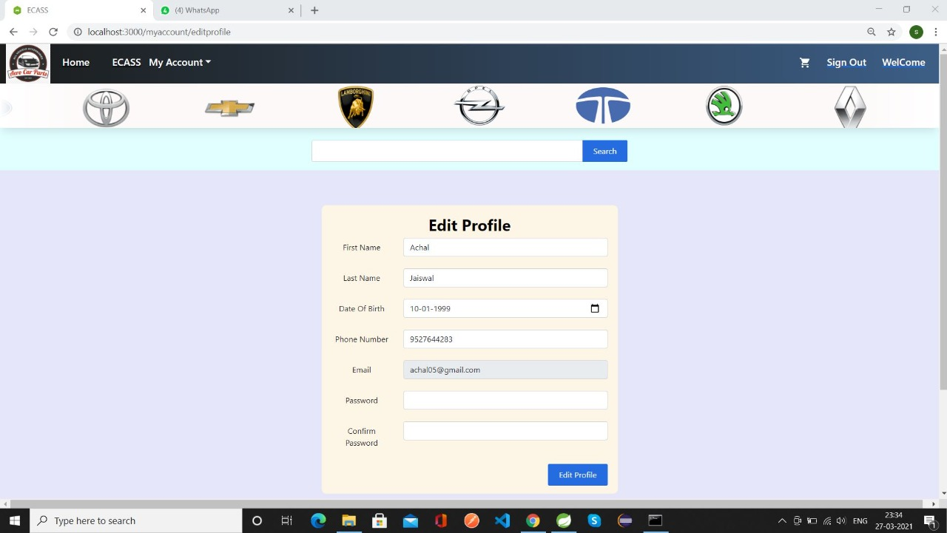
ECASS Edit Details Page for Customer

Slide 12
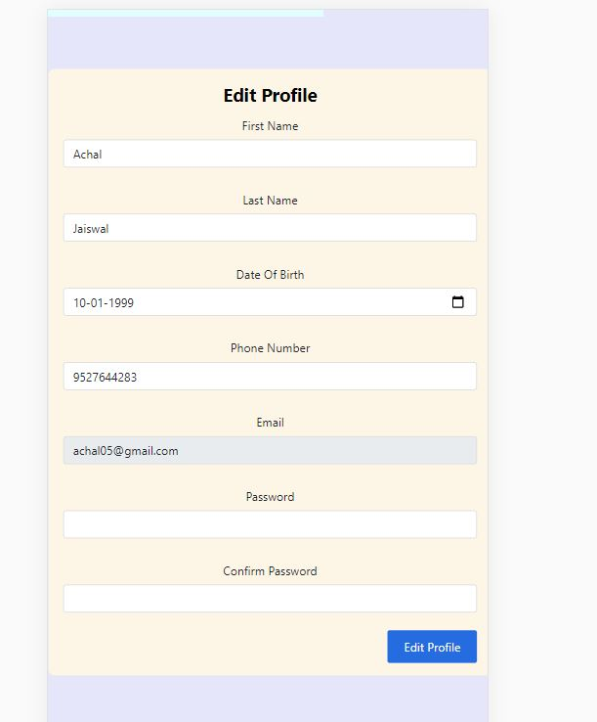
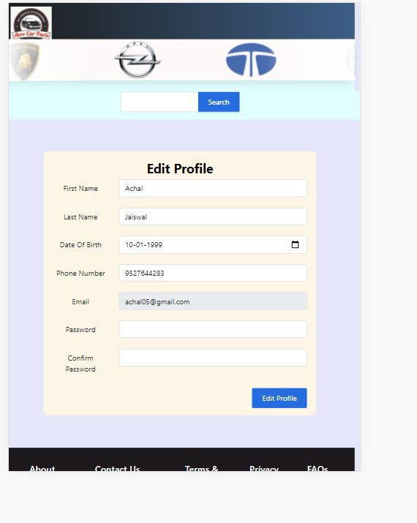
Edit customer details module.

Slide 13
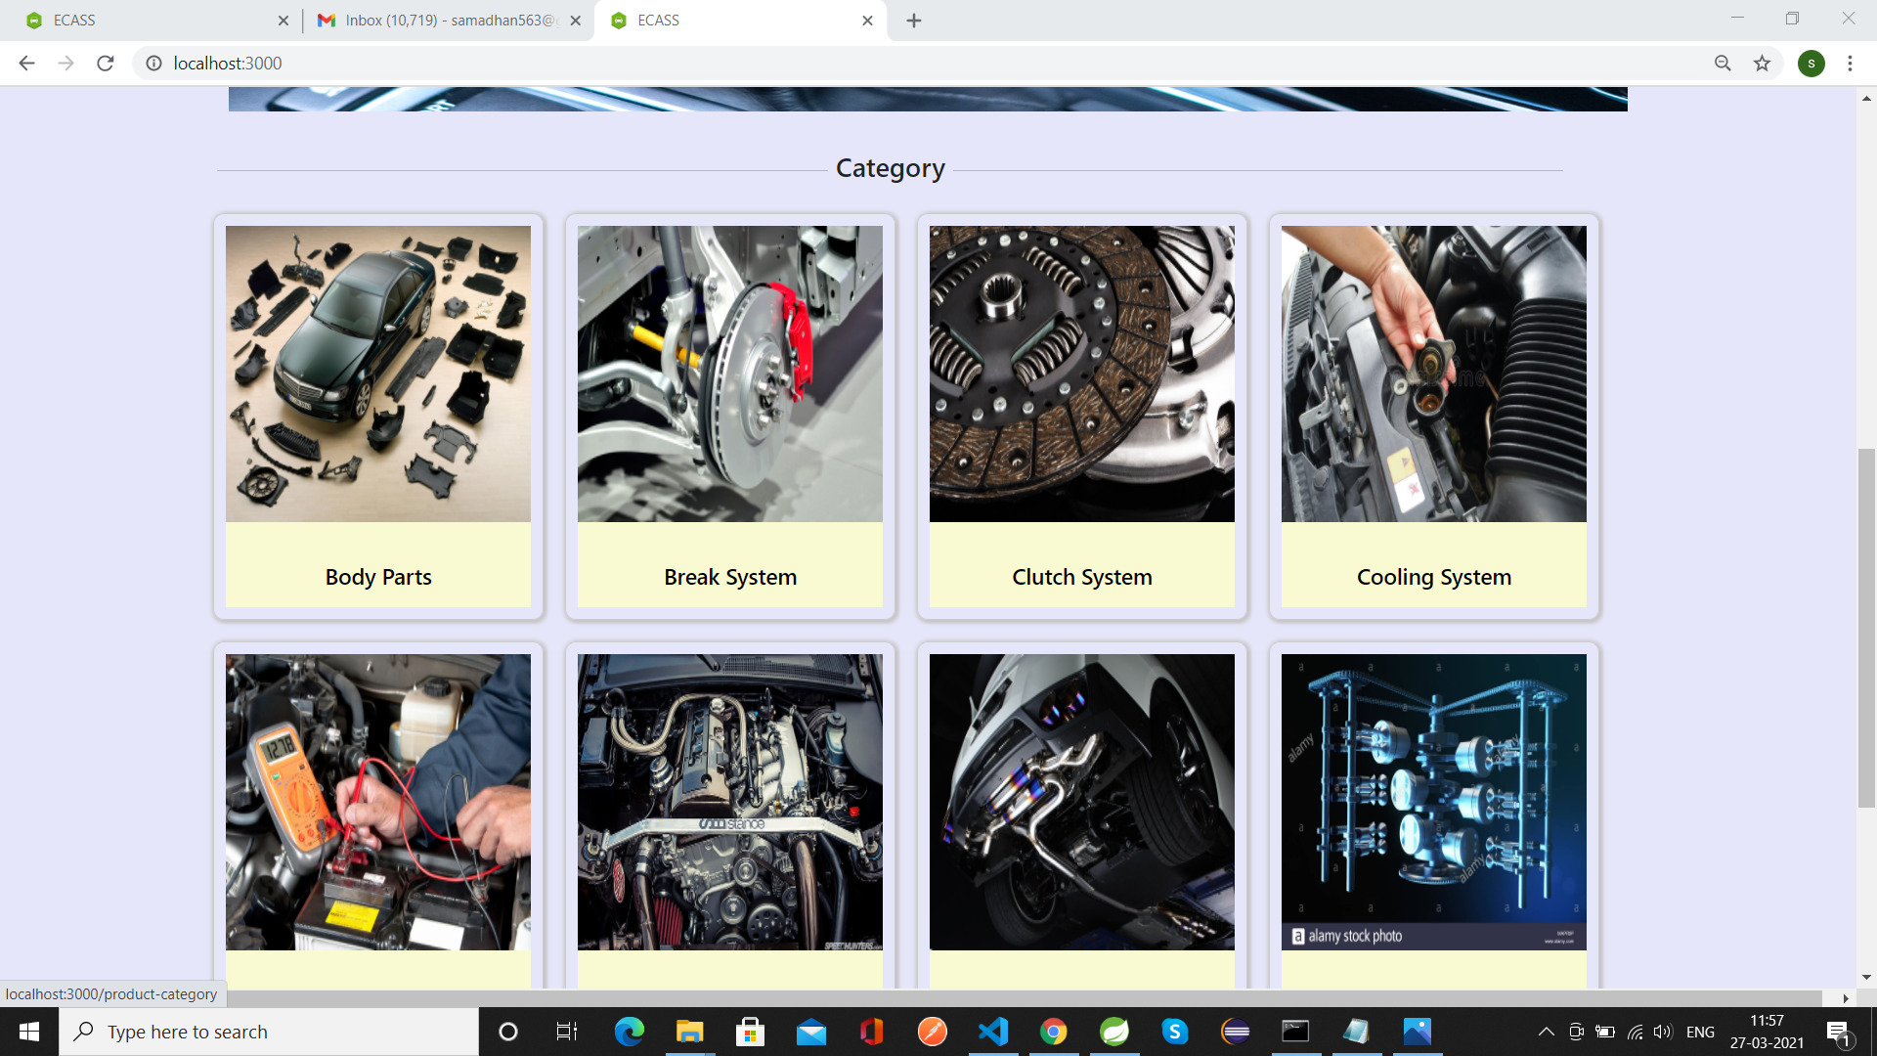
ECASS Product Catelog

Slide 14
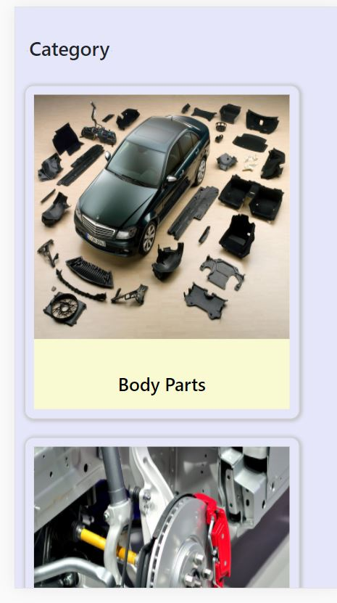
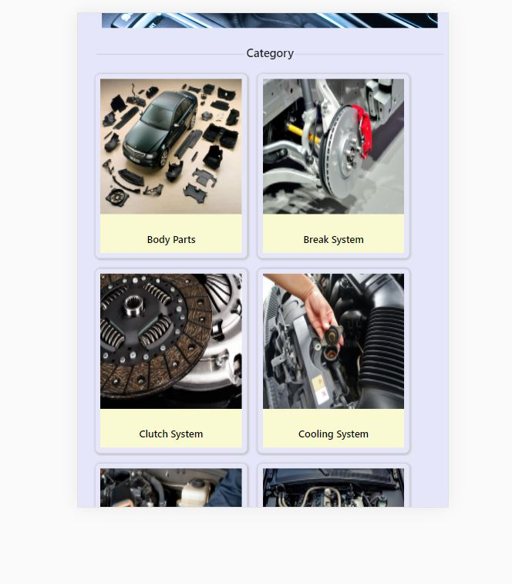
Shop by Categories

Slide 15
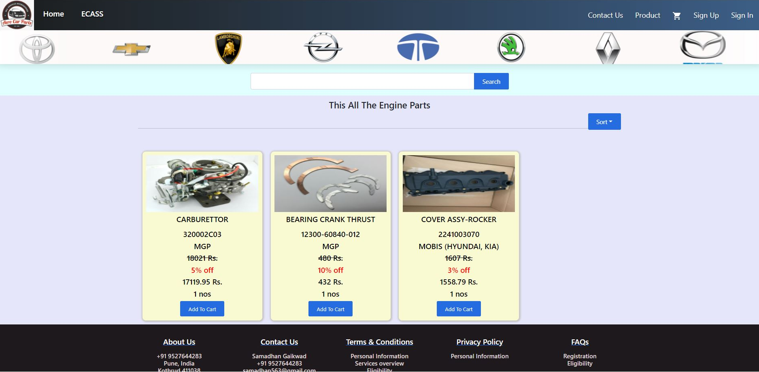
ECASS Product page

Slide 16
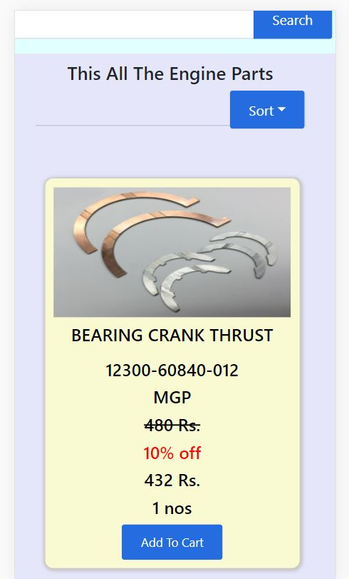
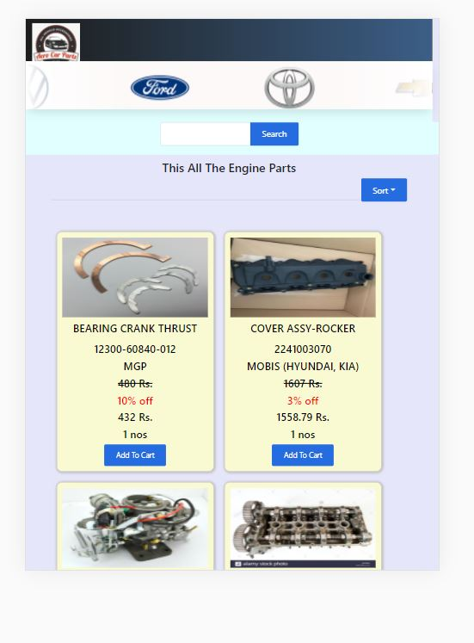
Product Page

Slide 17
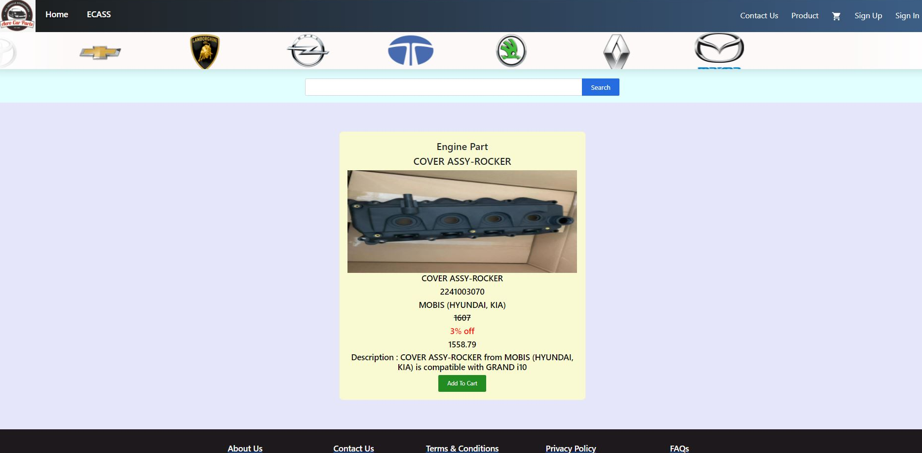
ECASS Product Details Page

Slide 18

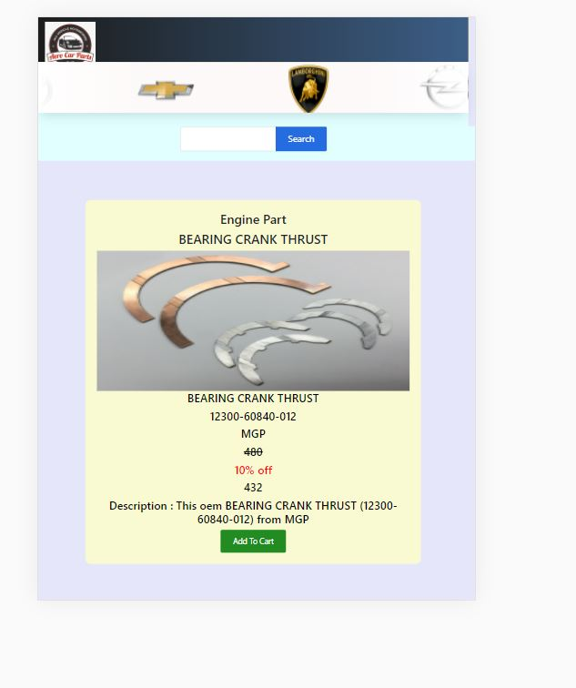
Product details

Slide 19
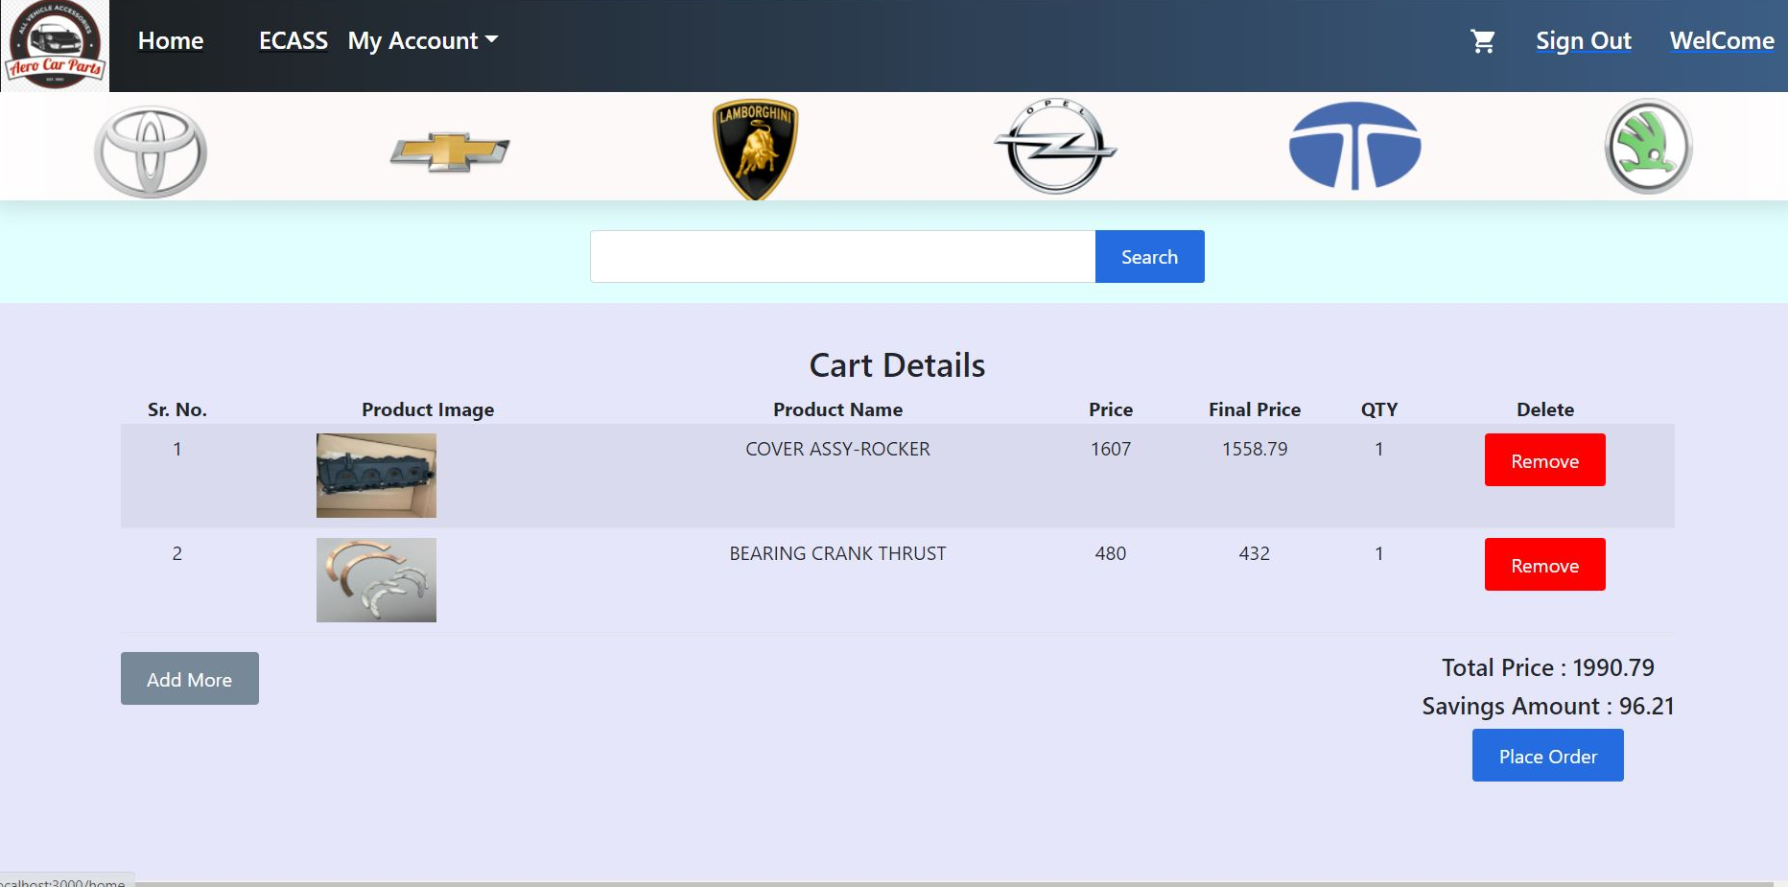
ECASS Shopping Cart

Slide 20
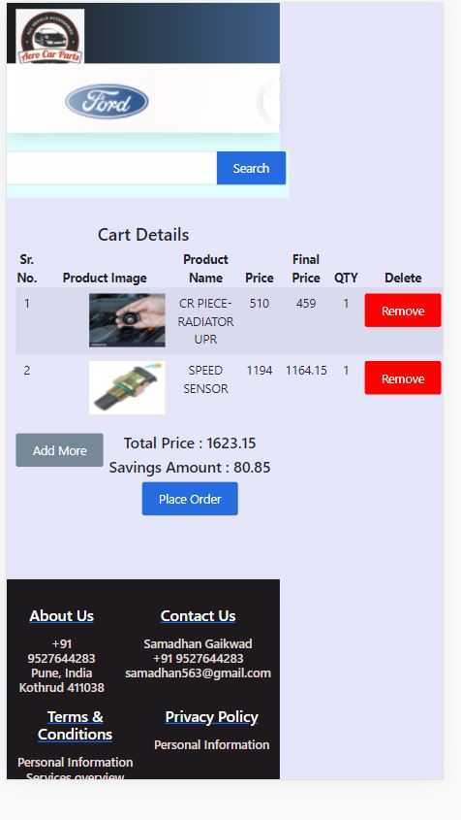
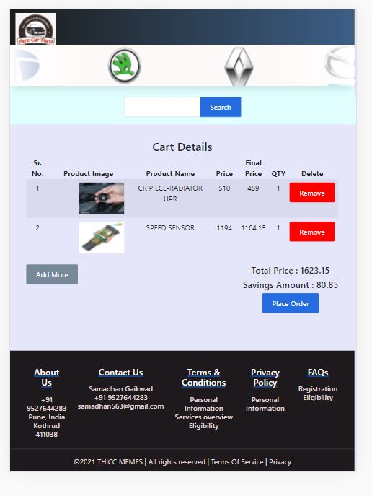
Shopping Cart

Slide 21
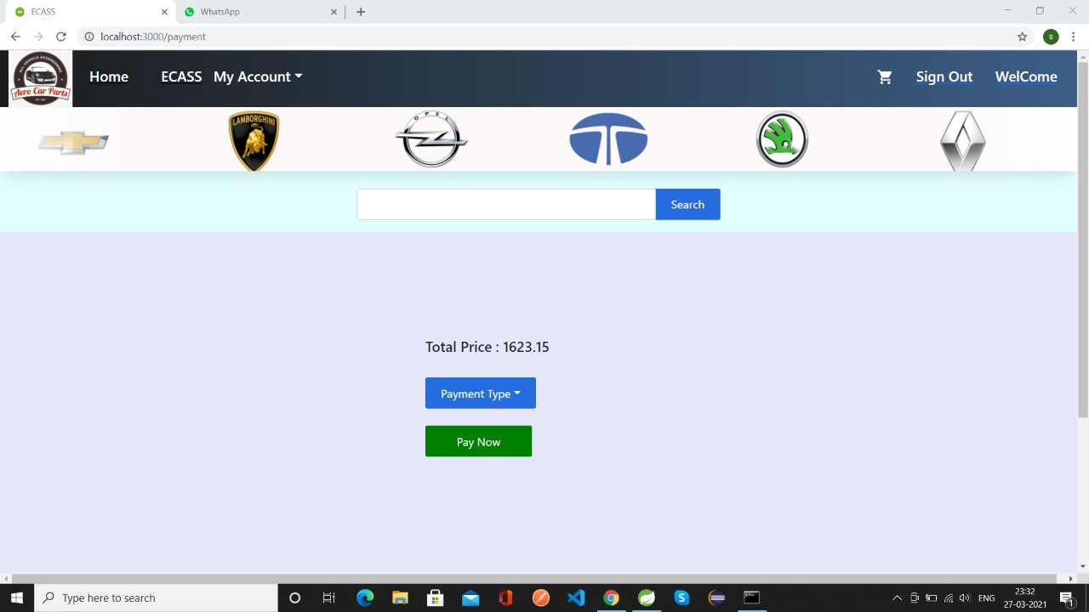
ECASS Checkout

Slide 22
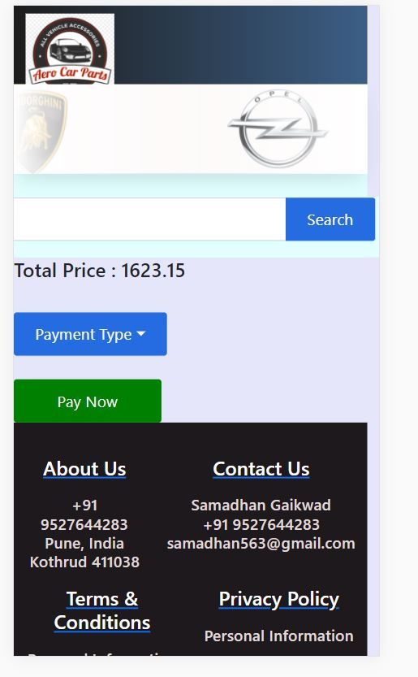
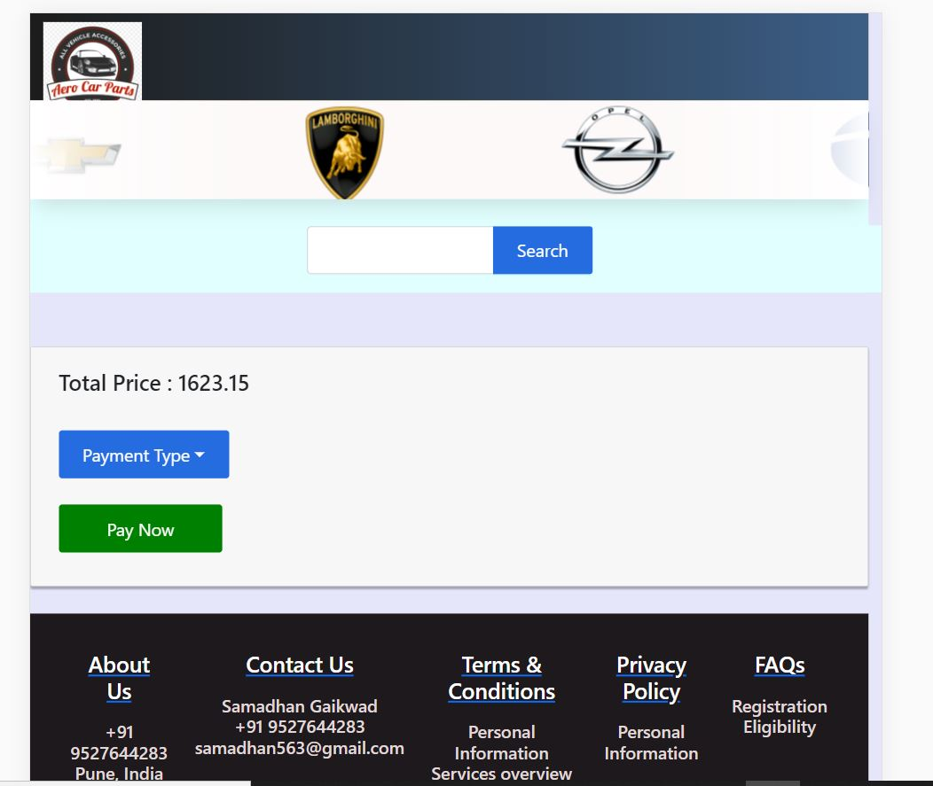
Payment module.

Slide 23
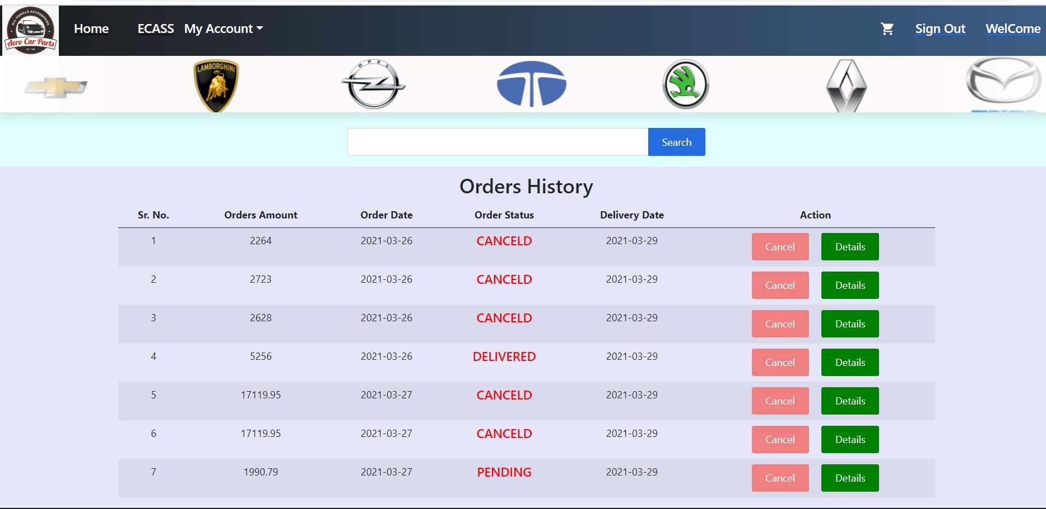
ECASS Order History page for Customer

Slide 24
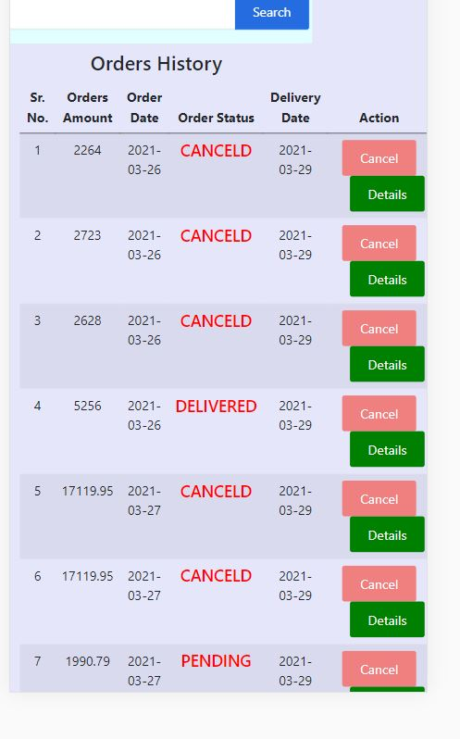
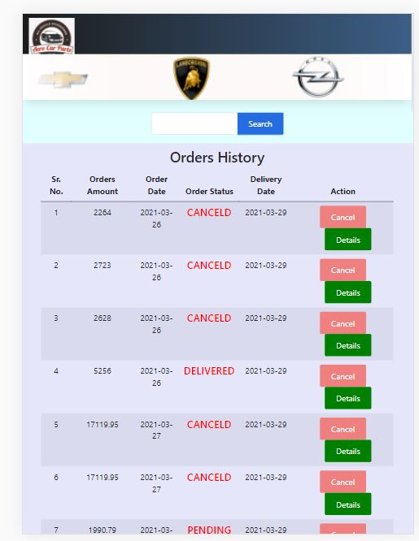
Orders History

Slide 25
FEATURES for SHOP OWNER(ADMIN)
01
02
03
Login
Profile
Managing users
Admin Login module
Admin Profile
Shop Owner may manage users

Slide 26
FEATURES for SHOP OWNER(ADMIN)
04
05
06
Managing Categories
Managing Products
Managing Orders
Shop Owner may manage their products categories
Shop owner may manage products.
Shop owner may manage orders.

Slide 27
ECASS Login Page for Admin

Slide 28
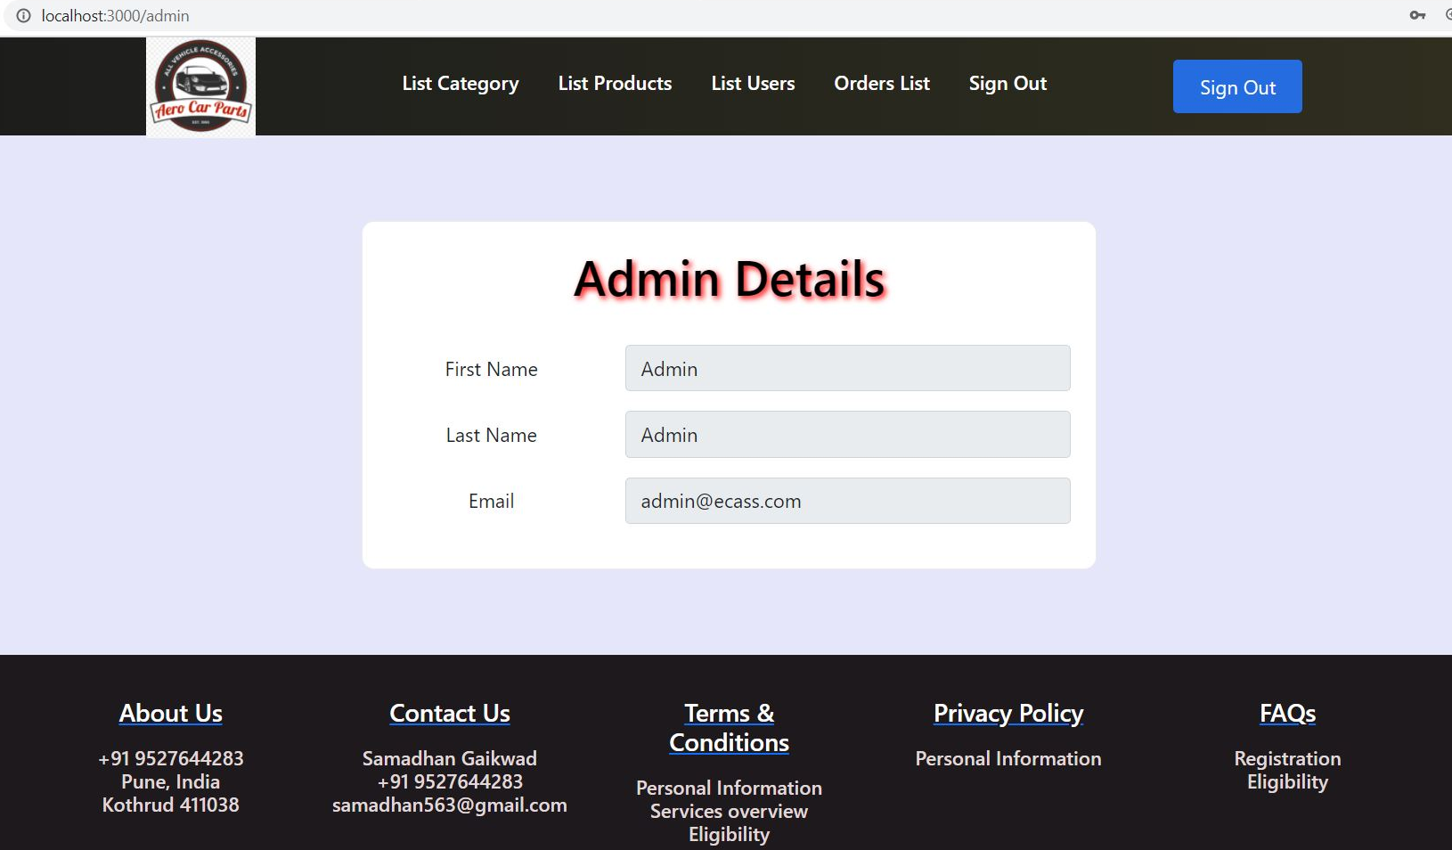
ECASS Admin Home

Slide 29
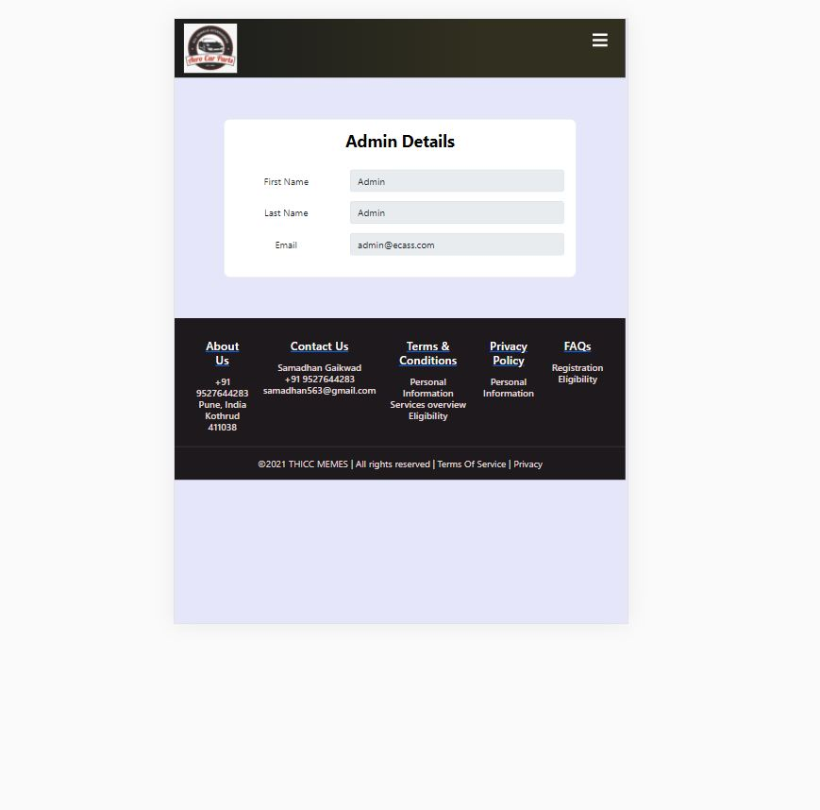
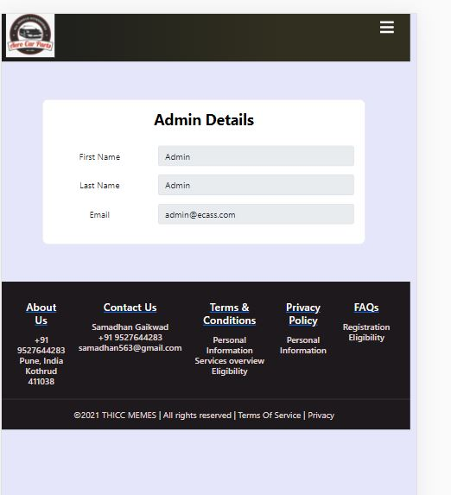
Admin Home module.

Slide 30
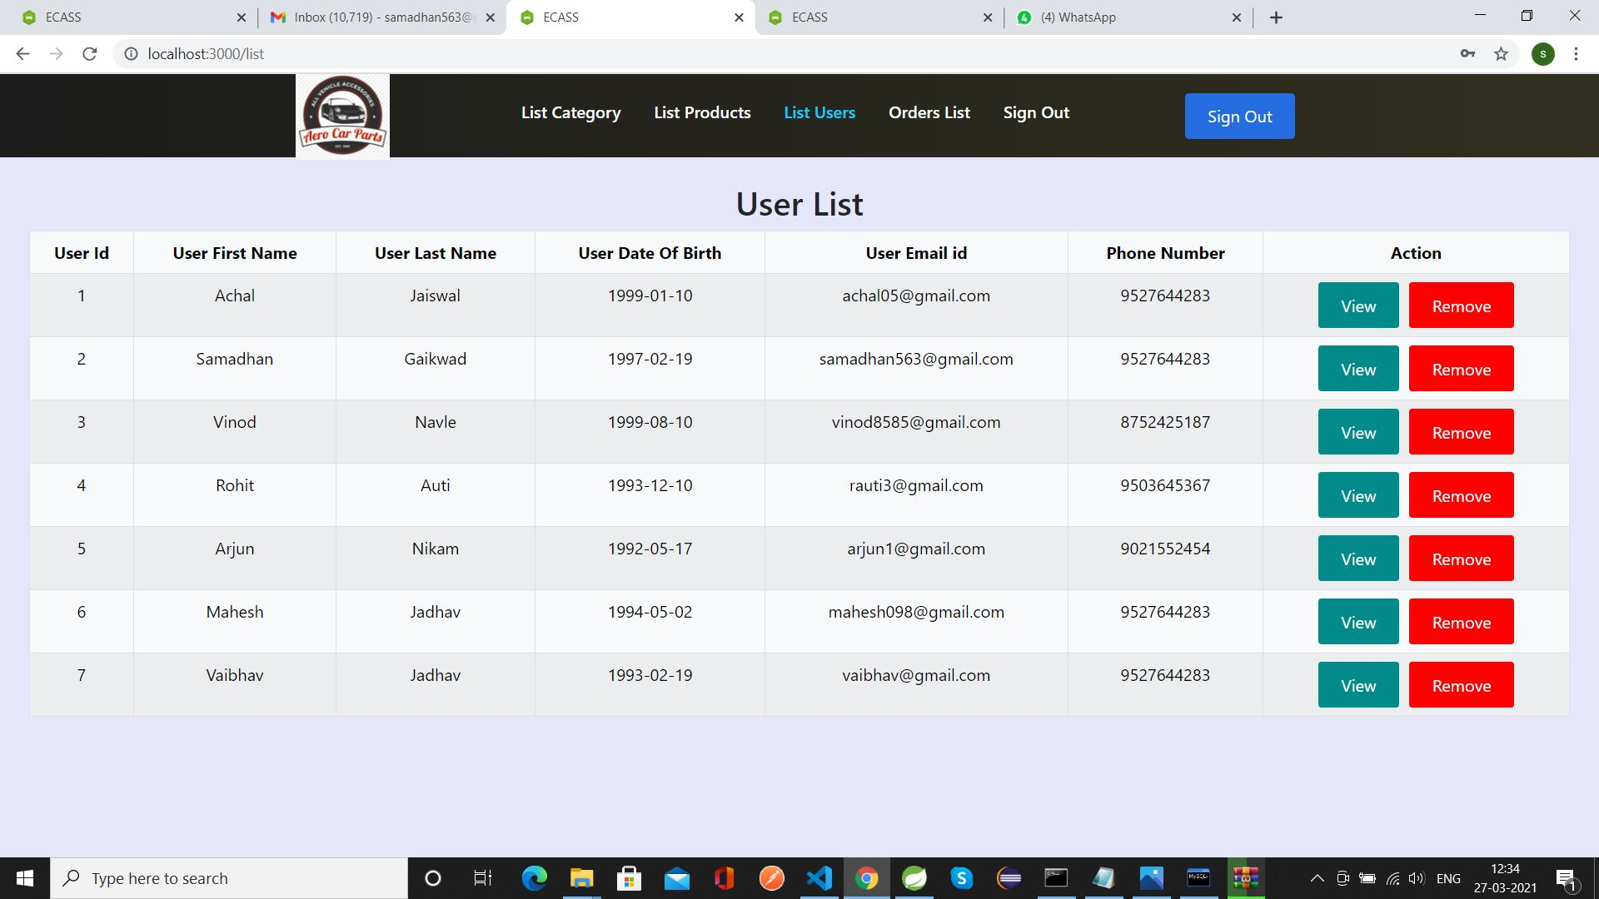
ECASS Manage Users by Admin

Slide 31
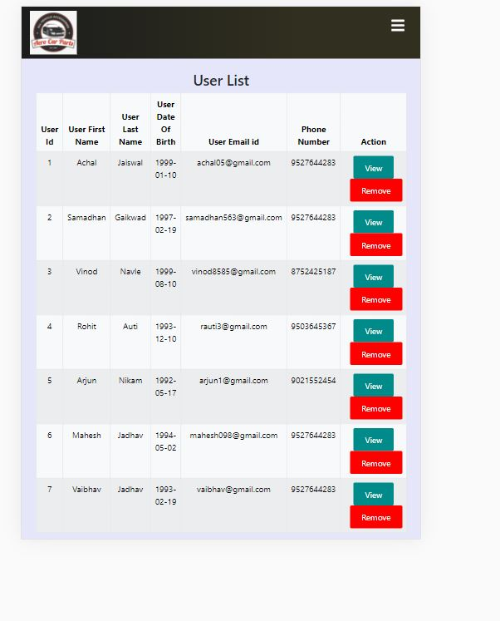
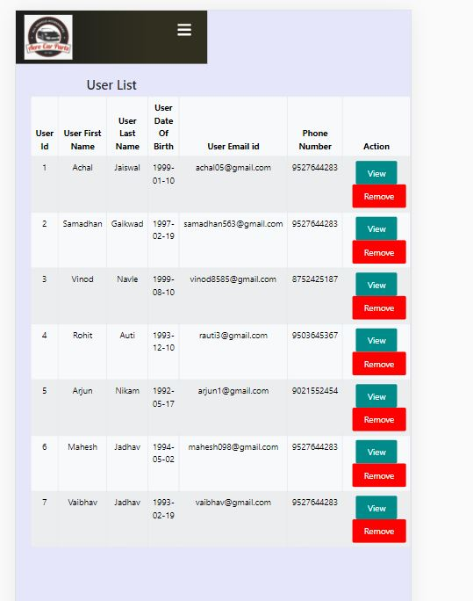
Managing Users module.

Slide 32
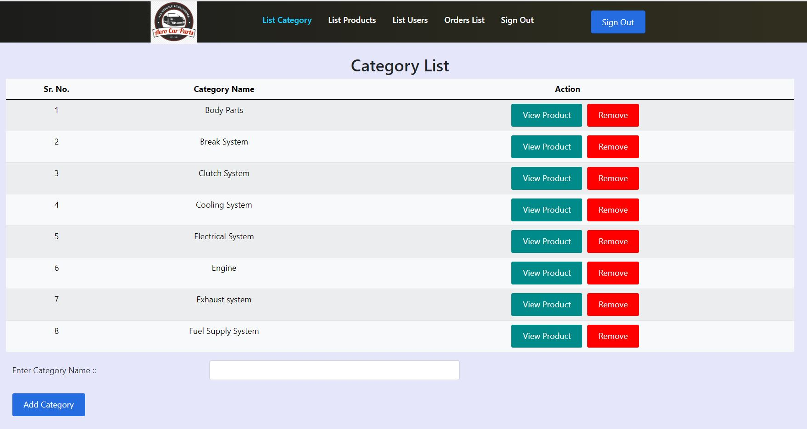
ECASS Manage Categories by Admin

Slide 33
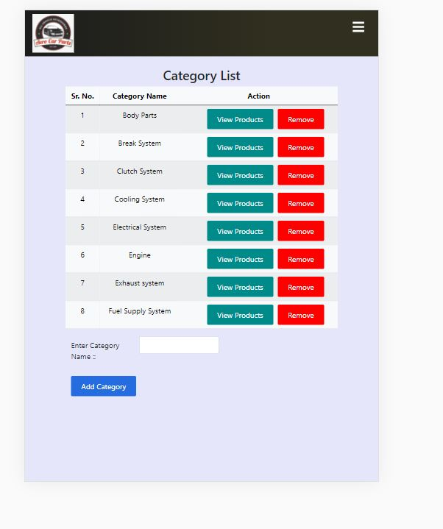
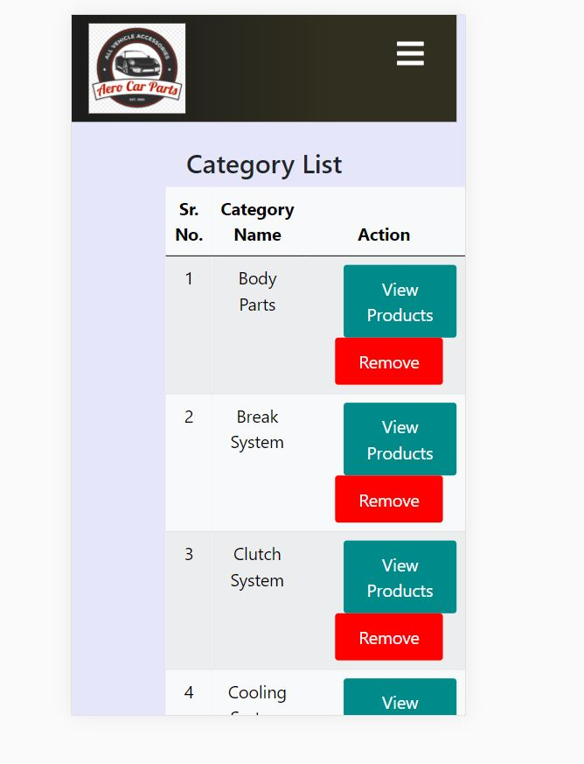
Manage Categories

Slide 34
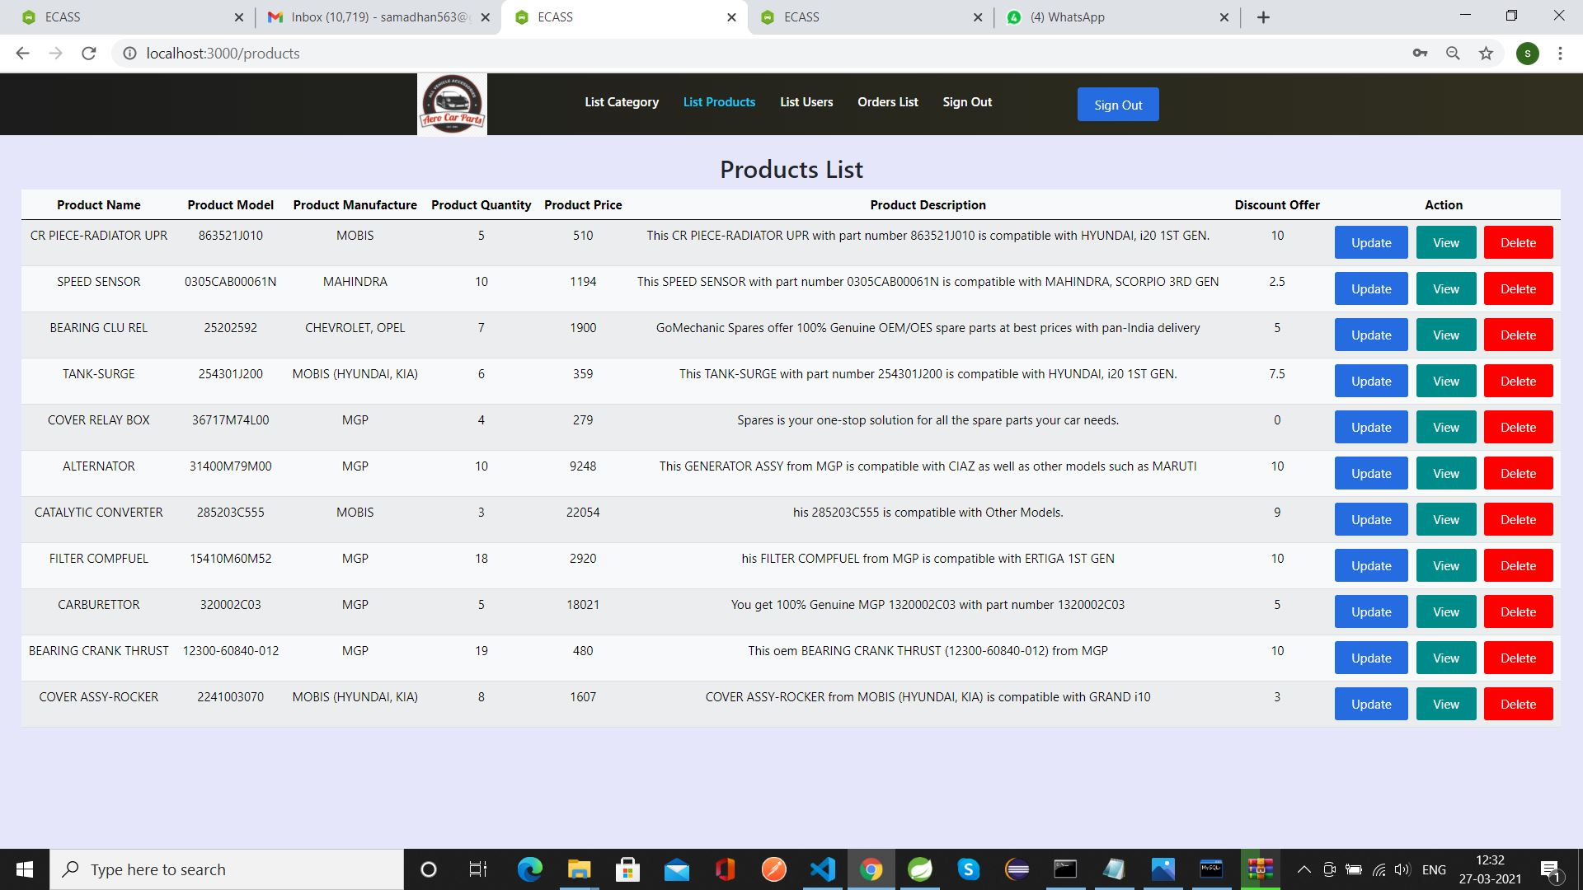
ECASS Manage Products by Admin

Slide 35
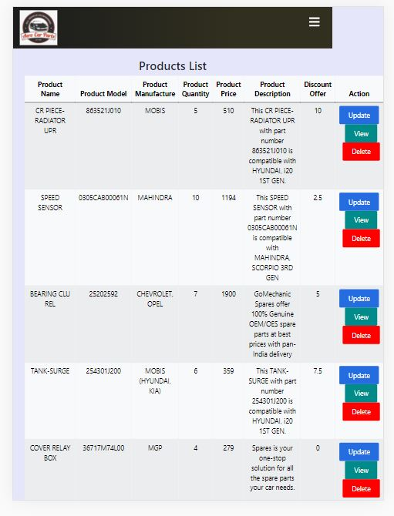
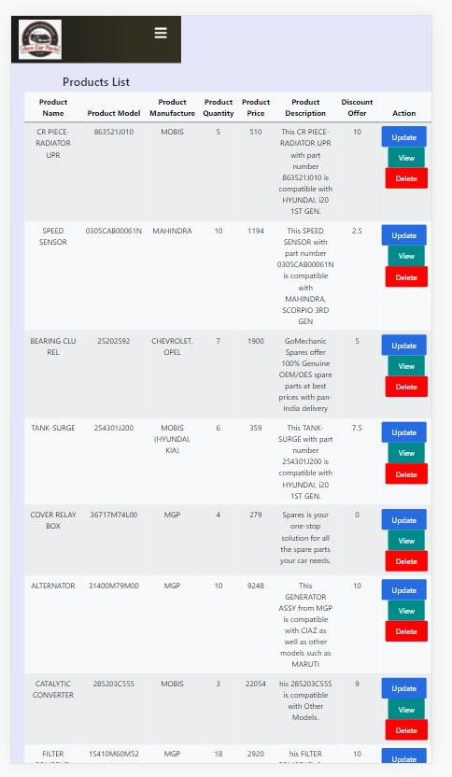
Managing Products module.

Slide 36
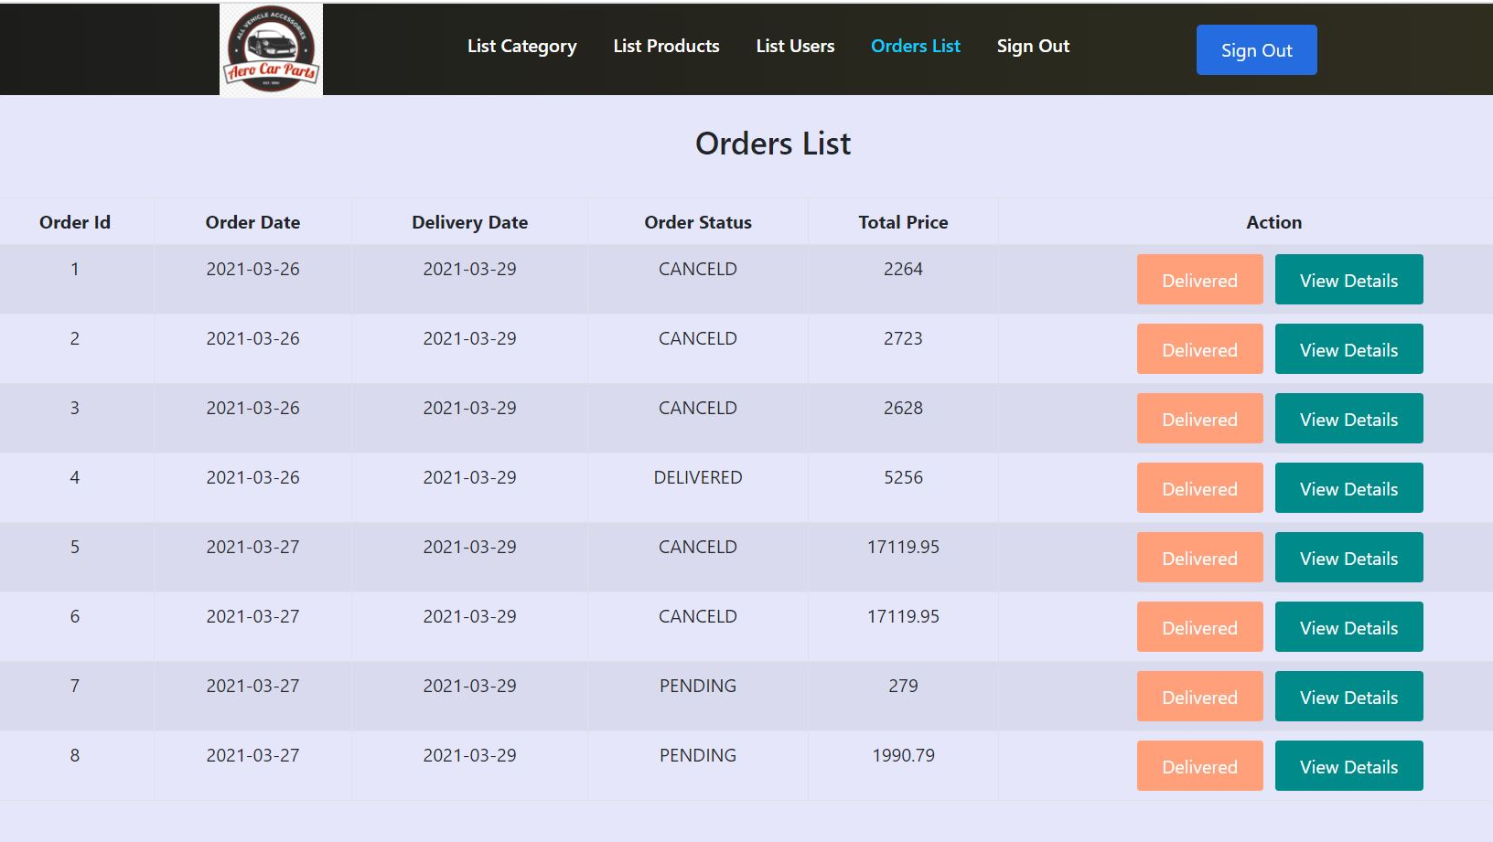
ECASS Manage Orders by Admin

Slide 37
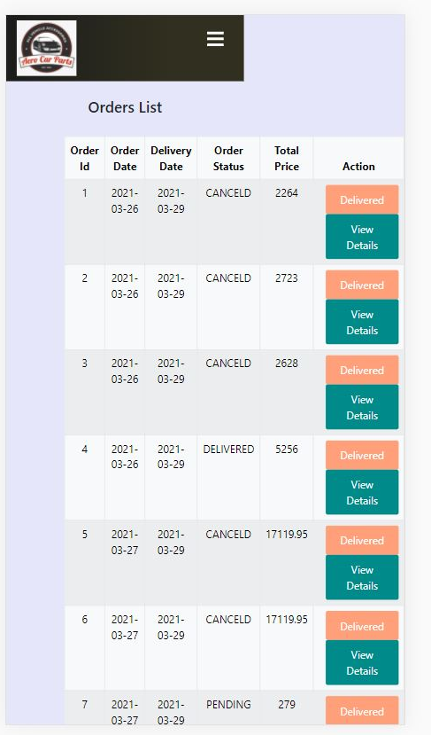
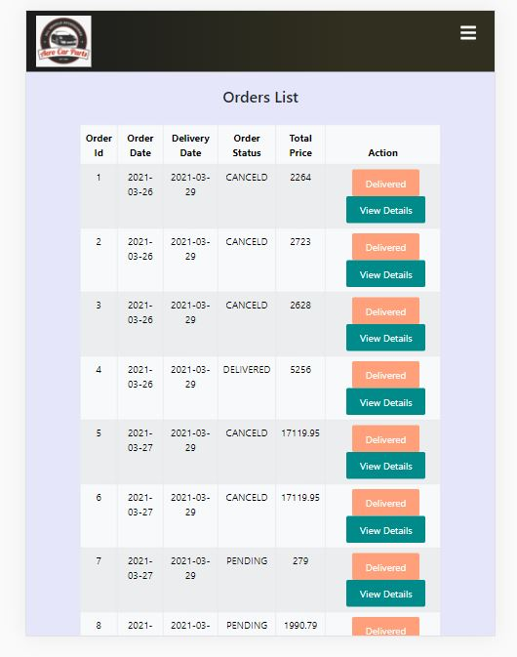
Managing Orders module.

Slide 38
Do You Have any Questions
?

Slide 39
THANK YOU…!!!
~ Achal & Samadhan

